Slide 1

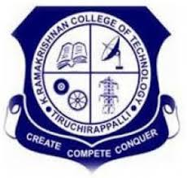
K.RAMAKRISHNAN COLLEGE OF TECHNOLOGY (AUTONOMOUS), TRICHY
GRAYSCALE IMAGE CONVERSION USING DEEP LEARNING
 | PRESENTED BY, ATHISH MA (811721243009) MITHUN KANTH M (811721243029) MUHIL AKSITH (811721243036)
GUIDED BY,
Mr.MUTHU KUMARAN M.E.,(Ph.D)
ASSISTANT PROFESSOR/ AI
6/5/24
1

Slide 2
PRESENTATION OVERVIEW
Introduction
Objective
Abstract
Literature Survey
Existing system
Disadvantages of existing system
Proposed system
Implementation model of proposed system
Explanation of proposed system
Advantages of proposed system
Results and Discussion
Conclusion
6/5/24
2

Slide 3
INTRODUCTION
Currently, most of the captured images are color images. However, it is frequently necessary to convert a color image to grayscale images for printing, aesthetic intents, object detection, and publishing as less expensive, helping colorblind people preserve visual cues.
Color-to-grayscale conversion is the process of reducing the image dimensions by transforming the RGB tristimulus values.
The goal of each conversion algorithm is to preserve the local luminance consistency, global consistency, image contrast information, and hue order as much as possible.
6/5/24
2

Slide 4
OBJECTIVE
The objective of this project is to create an advanced deep learning model for converting grayscale images to color. It will utilize techniques like Convolutional Neural Networks (CNNs) and Generative Adversarial Networks (GANs) to produce realistic and high-quality colorizations. The project aims to improve the visual appeal and details of images by learning complex patterns and color distributions. Additionally, it seeks to automate the colorization process, making it efficient and applicable for various real-world applications in image restoration and enhancement.
6/5/24
2

Slide 5
ABSTRACT
This project focuses on leveraging deep learning to automate the colorization of black-and-white images, a task that previously demanded significant human input and manual coding. By utilizing the latest advancements in neural networks, we have developed an efficient strategy that enables model training on a relatively small dataset with short training times. The project explores a variety of model architectures, loss functions, and training techniques, identifying both successful and ineffective strategies. The results demonstrate the potential for end-to-end colorization using modern AI techniques, with the implementation built using PyTorch. This approach simplifies the process while maintaining high-quality output, providing an innovative solution to image colorization challenges.
6/5/24
2

Slide 6
EXISTING SYSTEM
These networks learn to map color images to grayscale by training on large datasets.
GANs enhance grayscale image quality through adversarial training between a generator and a discriminator.
Architectures like U-Nets perform color-to-grayscale transformations while preserving details.
Transfer learning with pretrained models improves conversion accuracy and reduces training time.
Various loss functions ensure that grayscale images retain important features from the original color images.
6/5/24
2

Slide 7
LITERATURE SURVEY
S.NO | TITLE | JOURNAL | AUTHOR | DESCRIPTION
1 | Grayscale medical image segmentation method based on 2D&3D object detection with deep learning | BMC Medical Imaging,(2022) | Yunfei Ge,Qing Zhang,Yuantao Sun,Yidong Shen and Xijong Wang | A literature survey on grayscale medical image segmentation methods, focusing on 2D and 3D object detection techniques using deep learning for improved accuracy and efficiency.
2 | Colorization of Grayscale Images in Deep Learning | International Journal of Engineering Applied Sciences and Technology, 2022 Vol. 6, Issue 11, ISSN No. 2455-2143, Pages 203-212 | Angelica D Pyngrope, Dr.Pawan Kumar | A literature survey on deep learning techniques for colorizing grayscale images, exploring methods like GANs, CNNs, and encoder-decoder models for realistic colorization.
3 | Novel Unbiased Deep Learning Approach (DL-Net) in Feature Space for Converting Gray to Color Image | IEEE Access Research article, published in 2023 | Mrityunjoy Gain and Rameswar Debnath | A literature survey on DL-Net, a novel unbiased deep learning approach in feature space for converting grayscale images to color with enhanced accuracy and realism.
6/5/24
2

Slide 8
LITERATURE SURVEY
S.NO | TITLE | JOURNAL | AUTHOR | DESCRIPTION
4 | An Overview of the Most Important Methods for Coloring Grayscale Images | Al-Furat Journal of Innovations in Electronics and Computer Engineering (FJIECE) ISSN -2708-3985 , 2024 | Ali Abdulazeez Mohammedbaqer Qazzaz,Hayder Ali Alsabbagh | A literature survey on grayscale image coloring methods, covering traditional algorithms, deep learning approaches like CNNs, GANs, and colorization techniques for enhancing image realism and detail.
5 | Colorization of Grayscale Images using Deep Learning | International Journal of Computer Science and Engineering (IJCSE) ISSN(P): 2278–9960; ISSN(E): 2278–9979 Vol. 9, Issue 3, Apr–May 2020 | Apurva Pavaskar,Saurabh Dawkhar,Diksha kamble,Praneet Mugdiya and S.F.Sayyad | A literature survey on grayscale image colorization using deep learning, focusing on CNNs, GANs, and autoencoders for realistic and automatic colorization techniques.
6/5/24
2

Slide 9
PROPOSED SYSTEM
The system uses deep learning, specifically U-Net and GAN-based models, to automate the colorization of black-and-white images with minimal human input. It leverages efficient training techniques, including small datasets, loss functions like L2, perceptual, and adversarial loss, to produce high-quality results in a short time. Built with PyTorch, the system handles preprocessing, training, and post-processing, offering scalable and accurate colorization with potential for future improvements, such as user-defined color palettes and better handling of complex lighting conditions.

Slide 10
Advantage of proposed system
Efficiency: The system achieves high-quality colorization with relatively small datasets and short training times, making it computationally efficient.
High-Quality Output: By using advanced loss functions like L2, perceptual, and adversarial loss, the system produces visually appealing and realistic colorized images.
End-to-End Automation: It eliminates the need for manual intervention, offering a fully automated solution for colorizing black-and-white images.
Scalability: The system can handle various image types and can be adapted to larger datasets or different colorization challenges with minimal adjustments.
Flexibility: Future enhancements, like incorporating user-defined color palettes or improving handling of edge cases (e.g., unusual lighting or historical images), can further expand the system's applicability.

Slide 12
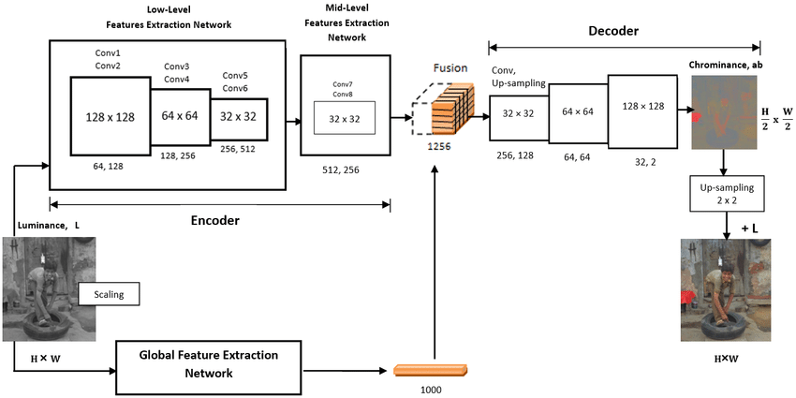
ARCHITECTURE

Slide 13
CONCLUSION
This project showcases the effectiveness of deep learning for automating black-and-white image colorization, achieving high-quality results with minimal data and training time.
Through careful selection of model architectures and loss functions, our PyTorch-based approach provides a streamlined, efficient solution to image colorization, reducing the need for manual input and making AI-powered colorization accessible for various applications.

Slide 14
THANK YOU
6/5/24
17

